Slide 1
파이썬 뿌수기
Dirichlet Process
이해중
22th November, 2020

Slide 2
참고사항
해당 자료는 KAIST 문일철 교수님의 “인공지능 및 기계학습 심화“ 강의 자료 및 PRML 자료를 토대로 다음의 자료들의 내용을 합쳐서 만들었습니다.
인공지능 및 기계학습 심화
PRML
Dirichlet Processes (code 구현)
Shahriari, B., Swersky, K., Wang, Z., Adams, R. P. & de Freitas, N. Taking the human out of the loop: a review of Bayesian optimization. Proc. IEEE 104, 148–175 (2016)

Slide 3
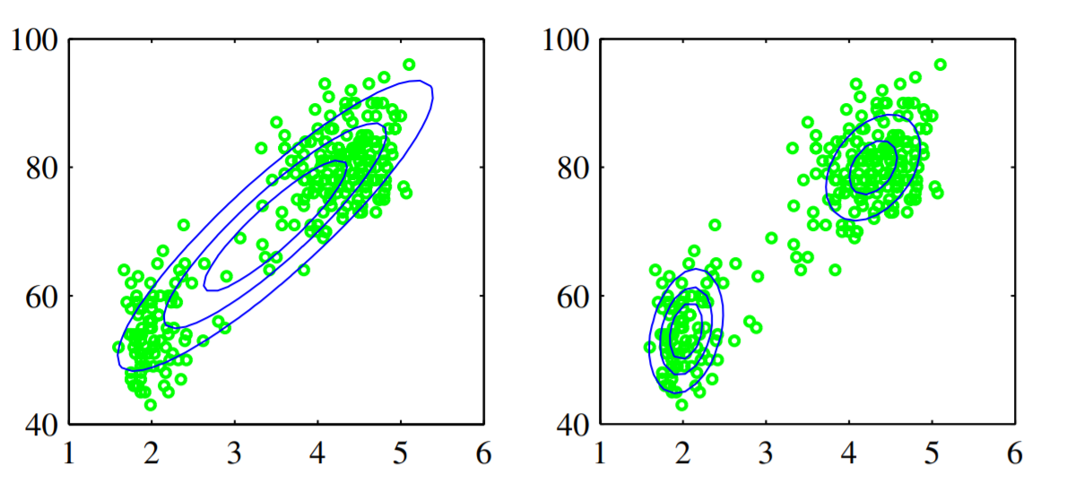
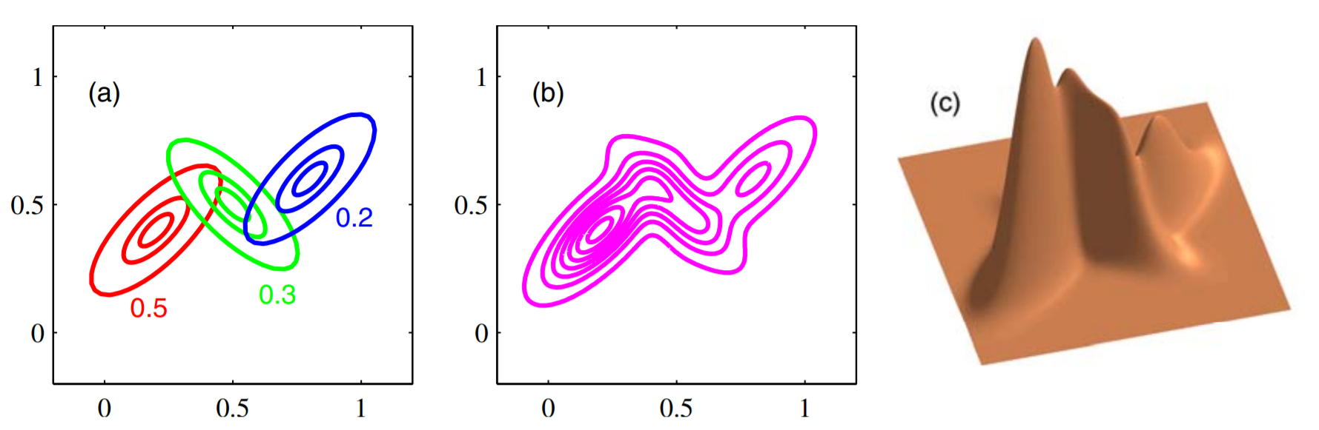

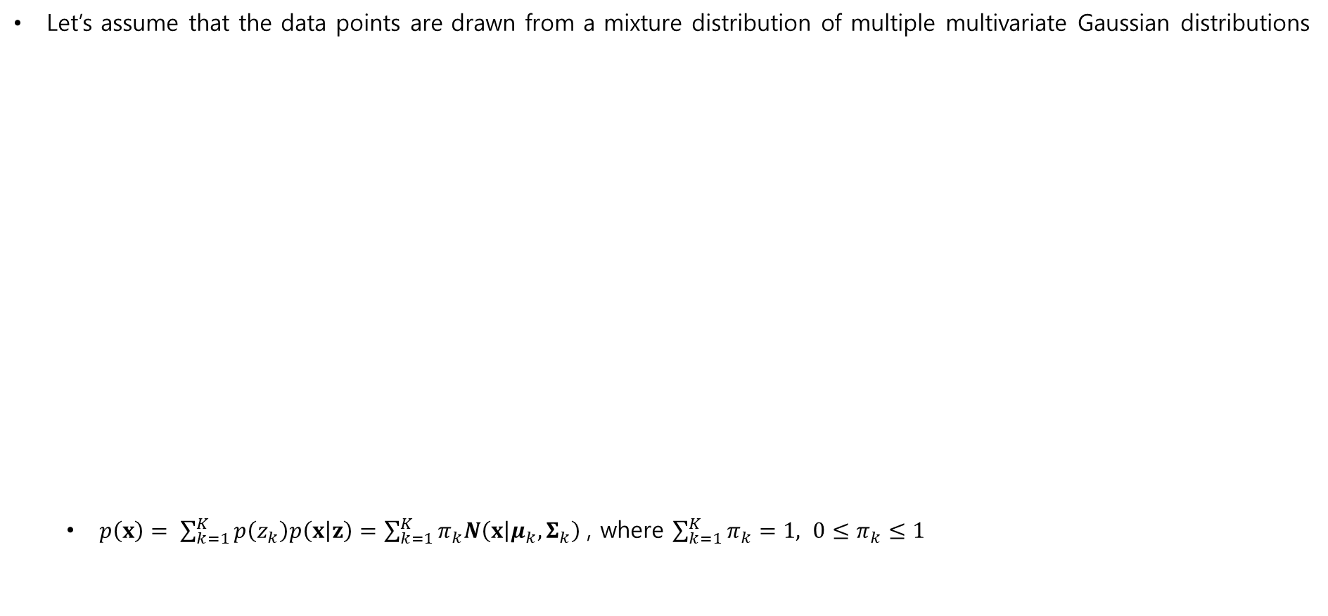





Dirichlet Process
Detour : Gaussian Mixture Model (GMM)
Let’s assume that the data points are drawn from a mixture distribution of multiple multivariate Gaussian distributions
$p\left(x\right)= \sum_{k=1}^{K}{p\left(z_{k}\right)p\left(x | z\right)=\sum_{k=1}^{K}{π_{k}N\left(x | μ_{k},Σ_{k}\right) }}$, where $\sum_{k=1}^{K}{π_{k}}=1, 0≤π_{k}≤1$
parameter
$$π$$
model의 size는
$z$에 dependent함
bad
good
parameter
$$z$$
single Gaussian distribution
a linear combination of two Gaussians
$$μ$$
$$Σ$$
$$x$$
N
Entire data set

Slide 4
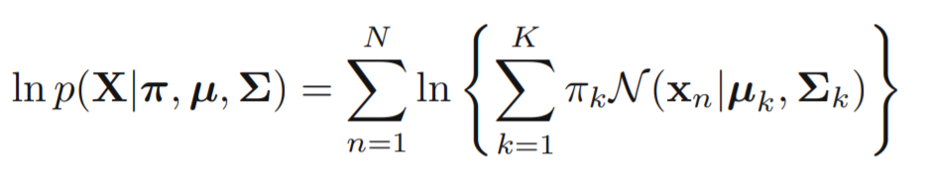
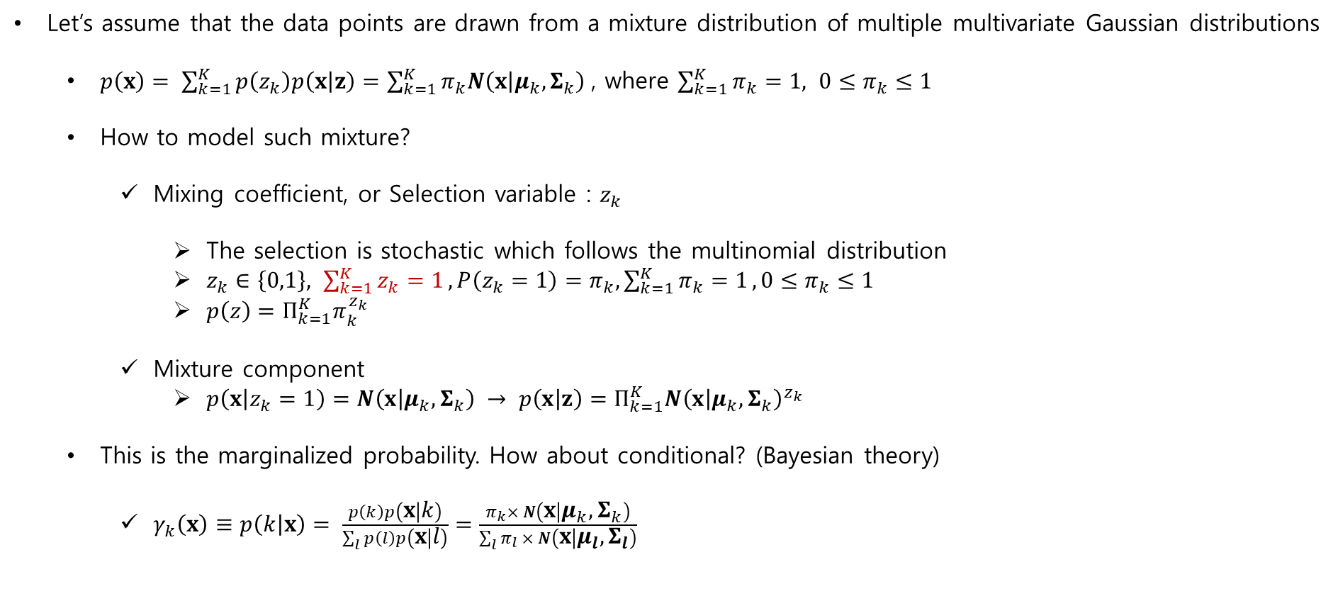
Dirichlet Process
Detour : Gaussian Mixture Model (GMM)
Let’s assume that the data points are drawn from a mixture distribution of multiple multivariate Gaussian distributions
$p\left(x\right)= \sum_{k=1}^{K}{p\left(z_{k}\right)p\left(x | z\right)=\sum_{k=1}^{K}{π_{k}N\left(x | μ_{k},Σ_{k}\right) }}$, where $\sum_{k=1}^{K}{π_{k}}=1, 0≤π_{k}≤1$
How to model such mixture?
Mixing coefficient, or Selection variable : $z_{k}$
The selection is stochastic which follows the multinomial distribution
$z_{k}∈\left\{0,1\right\}, \sum_{k=1}^{K}{z_{k}=1},P\left(z_{k}=1\right)=π_{k},\sum_{k=1}^{K}{π_{k}=1},0≤π_{k}≤1$
$p\left(z\right)=Π_{k=1}^{K}π_{k}^{z_{k}}$
Mixture component
$p\left(x | z_{k}=1\right)=N\left(x | μ_{k},Σ_{k}\right) → p\left(x | z\right)=Π_{k=1}^{K}{N\left(x | μ_{k},Σ_{k}\right)}^{z_{k}}$
This is the marginalized probability. How about conditional? (Bayesian theory)
$γ_{k}\left(x\right)≡p\left(k | x\right)= \frac{p\left(k\right)p\left(x | k\right)}{\sum_{l}{p\left(l\right)p\left(x | l\right)}}=\frac{π_{k}× N\left(x | μ_{k},Σ_{k}\right)}{\sum_{l}{π_{l} × N\left(x | μ_{l},Σ_{l}\right)}}$
$\text{m}\text{ixture} \text{component} :k$가 주어졌을 때의 $x의$ 확률
mixing coefficient : $k$번째 성분을 뽑을 사전 확률로 볼 수 있음
Responsibilities : 책임값

Slide 5
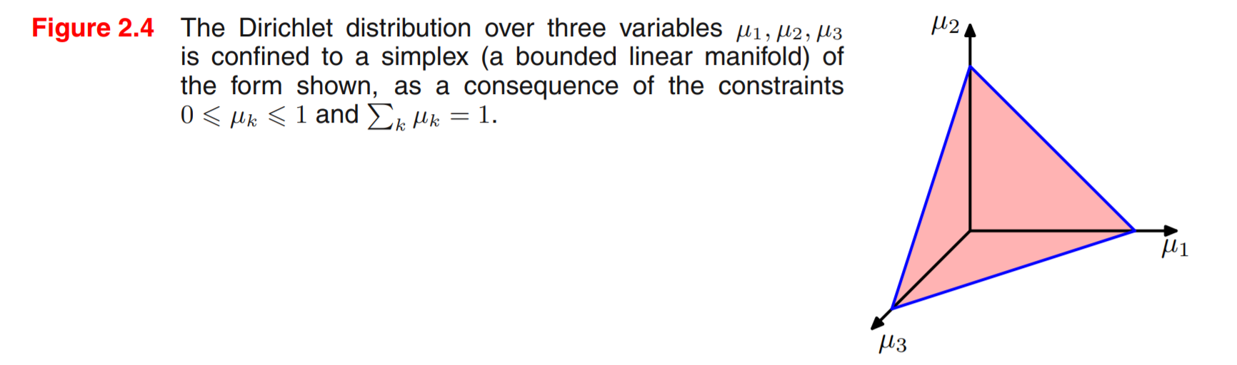
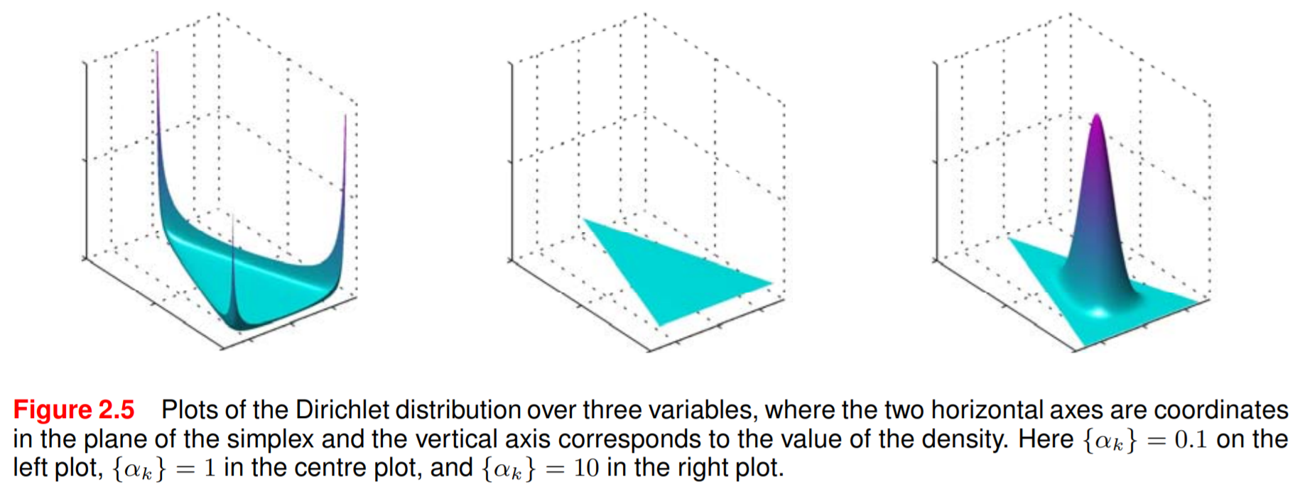






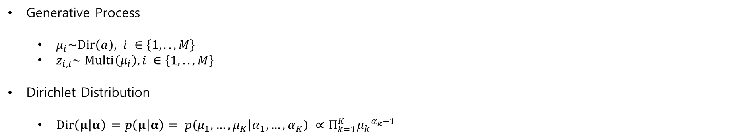
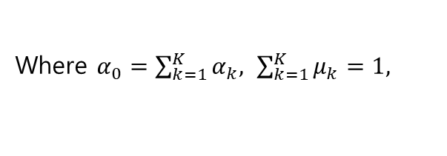
Dirichlet Process
Detour : Dirichlet Distribution
Generative Process
$μ_{i}\sim Dir\left(a\right), i ∈\left\{1, .., M\right\}$
$z_{i,l}\sim Multi\left(μ_{i}\right),i ∈\left\{1, .., M\right\}$
Dirichlet Distribution
$Dir\left(μ | α\right)$ $=p\left(μ | α\right)= p\left(μ_{1}, …,μ_{K} | α_{1}, …,α_{K}\right) ∝Π_{k=1}^{K}{μ_{k}}^{α_{k}−1}$
parameter
parameter
$$a$$
$$θ$$
$$z$$
$$w$$
$$β$$
N
M
$$={\frac{Γ(α_{0})}{Γ\left(α_{1}\right)⋯Γ(α_{K})}Π}_{k=1}^{K}{μ_{k}}^{α_{k}−1}$$
Where $α_{0}=\sum_{k=1}^{K}{α_{k}, \sum_{k=1}^{K}{μ_{k}=1,}}$

Slide 6

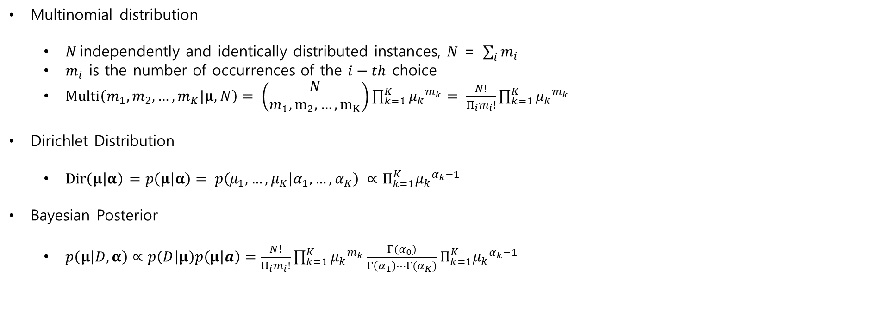

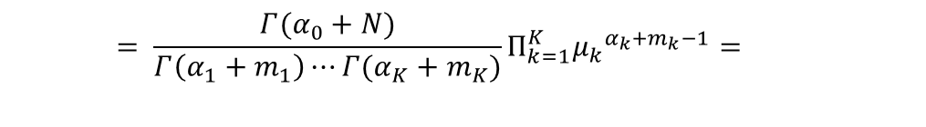
Dirichlet Process
Detour : Multinomial-Dirichlet Conjugate Relation
Multinomial distribution
$N \text{independently} \text{and} \text{identically} \text{distributed} \text{instances}\text{, }\text{N} \text{=} \sum_{i}{m_{i}}$
$m_{i}$ is the number of occurrences of the $i−th$ choice
$Multi\left(m_{1},m_{2}, …,m_{K}|μ, N\right)= \left(\begin{aligned}N \\ m_{1},m_{2}, …,m_{K}\end{aligned}\right)\prod_{k=1}^{K}{{μ_{k}}^{m_{k}}}= \frac{N!}{Π_{i}m_{i}!}\prod_{k=1}^{K}{{μ_{k}}^{m_{k}}}$
Dirichlet Distribution
$Dir\left(μ | α\right)$ $=p\left(μ | α\right)= p\left(μ_{1}, …,μ_{K} | α_{1}, …,α_{K}\right) ∝Π_{k=1}^{K}{μ_{k}}^{α_{k}−1}$
Bayesian Posterior
$p\left(μ | D,α\right)∝p\left(D | μ\right)p\left(μ | a\right)=\frac{N!}{Π_{i}m_{i}!}\prod_{k=1}^{K}{{μ_{k}}^{m_{k}}}{\frac{Γ(α_{0})}{Γ\left(α_{1}\right)⋯Γ(α_{K})}Π}_{k=1}^{K}{μ_{k}}^{α_{k}−1}$
$$={\frac{Γ(α_{0})}{Γ\left(α_{1}\right)⋯Γ(α_{K})}Π}_{k=1}^{K}{μ_{k}}^{α_{k}−1}$$
likelihood function
posterior
prior
$$= {\frac{Γ(α_{0}+N)}{Γ\left(α_{1}+m_{1}\right)⋯Γ(α_{K}+m_{K})}Π}_{k=1}^{K}{μ_{k}}^{α_{k}+m_{k}−1}=$$
$Dir\left(μ | α+m\right)$

Slide 7


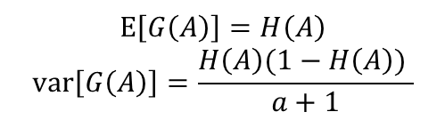









Dirichlet Process
$$Dir\left(μ | α_{1}, …,α_{K}\right)$$
Dirichlet process
PDF (확률분포) : parameter($α$)의 base를 만들어내는 확률분포
Definition : $G|α, H\sim DP(α, H)$
($G\left(A_{1}\right), …, G(A_{r})) |α, H\sim Dir(aH\left(A_{1}\right), …,aH(A_{r}))$
$A_{1}{∩…∩A}_{r}=∅$
$A_{1}∪…{∪A}_{r}=Ω$
Properties
H : base distribution
$α$ : Concentration parameter, strength parameter (strength of prior)
(DP와 Dir의 $α$는 같은 $α$ 인가?)
Posterior distribution given a dataset of $μ_{1}, …μ_{n}$
Posterior $∝$ Likelihood x Prior
Multinomial-Dirichlet conjugate relationship
The posterior becomes the Dirichlet distribution, again, adjusted to reflect the likelihood
($G\left(A_{1}\right), …, G(A_{r})) |μ_{1}, …μ_{n},α, H\sim Dir(aH\left(A_{1}\right) +n_{1}, …,aH\left(A_{r}\right)+n_{r})$
$n_{k}=|\{μ_{i}|μ_{i}∈A_{k}, 1≤i≤n\}|$
Stochastic Process
$$Ω$$
$$A_{1}$$
$$A_{3}$$
$$A_{r}$$
exclusive
control
$r$ → $∞$
exhaustive
$$A_{2}$$
Assume, |$Ω$| = 1 → |$A_{r}$| = $p$($A_{r}$)
$$E\left[G\left(A\right)\right]=H\left(A\right)$$
$$var\left[G\left(A\right)\right]=\frac{H\left(A\right)(1−H\left(A\right)) }{a+1}$$
base probability measure로, 연속인 확률분포를 가짐
$α >0, DP 에$서 나온 sample들이 얼마나
base 함수 H와 가까운지를 조절하는 parameter
count
$G|μ_{1}, …μ_{n},α, H \sim DP(α+n,\frac{a}{a+n}H+\frac{n}{a+n}\frac{\sum_{i=1}^{n}{δ_{μ_{i}}}}{n})$
posterior
Data 에서 나온 정보(Evidence)

Slide 8
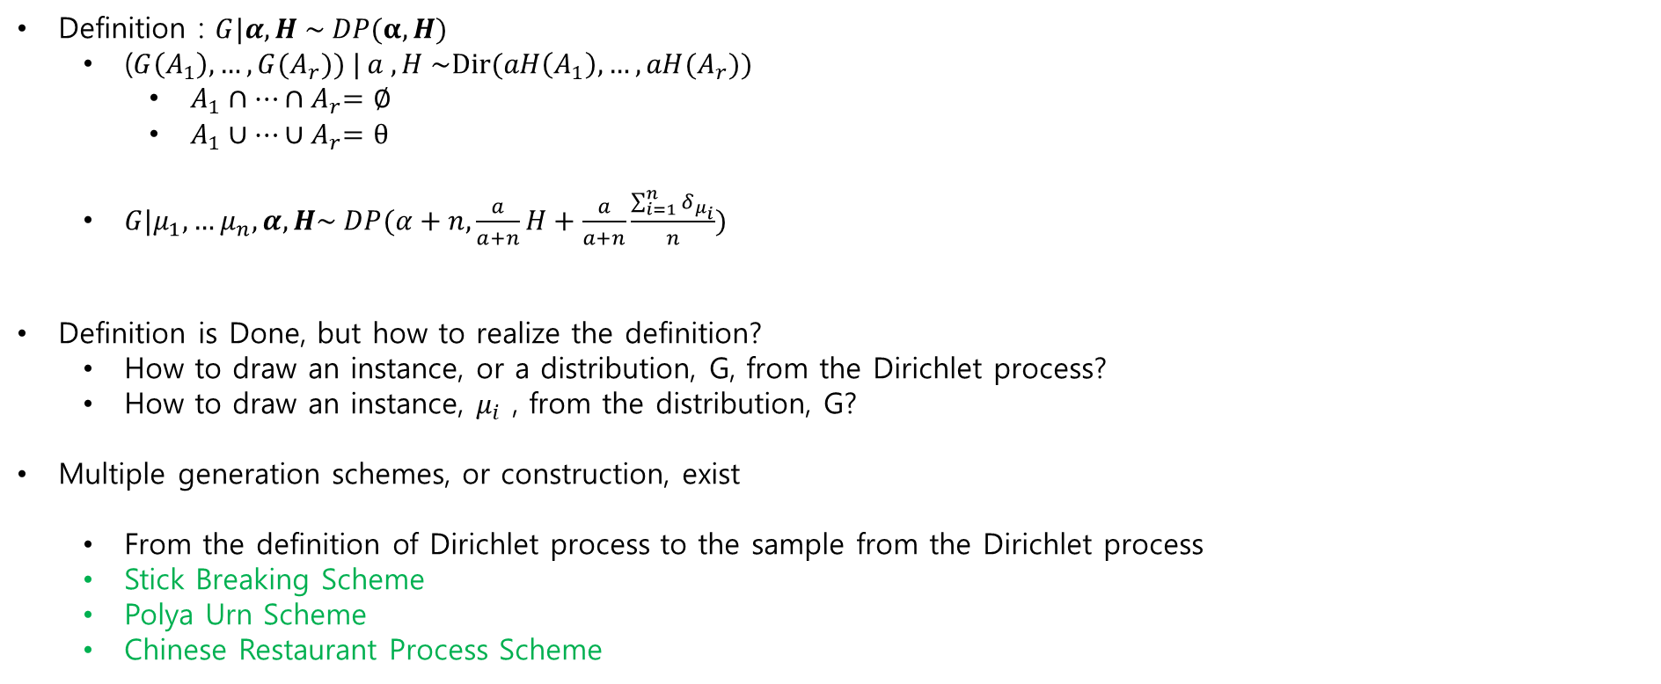
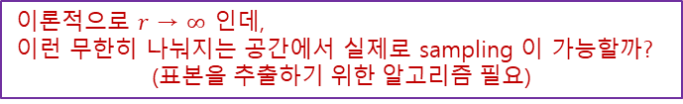
Dirichlet Process
$$Dir\left(μ | α_{1}, …,α_{K}\right)$$
Dirichlet process
PDF (확률분포) : parameter($α$)의 base를 만들어내는 확률분포
Definition : $G|α, H \sim DP(α,H)$
($G\left(A_{1}\right), …, G(A_{r})) | a , H \sim Dir(aH\left(A_{1}\right), …,aH(A_{r}))$
$A_{1}{∩…∩A}_{r}=∅$
$A_{1}∪…{∪A}_{r}=θ$
$G|μ_{1}, …μ_{n},α, H\sim DP(α+n,\frac{a}{a+n}H+\frac{a}{a+n}\frac{\sum_{i=1}^{n}{δ_{μ_{i}}}}{n})$
Definition is Done, but how to realize the definition?
How to draw an instance, or a distribution, G, from the Dirichlet process?
How to draw an instance, $μ_{i}$ , from the distribution, G?
Multiple generation schemes, or construction, exist
From the definition of Dirichlet process to the sample from the Dirichlet process
Stick Breaking Scheme
Polya Urn Scheme
Chinese Restaurant Process Scheme
$$Ω$$
$$A_{r}$$
$$A_{1}$$
$$A_{3}$$
$r$ → $∞$
$$A_{2}$$
Assume, |$Ω$| = 1 → |$A_{r}$| = $p$($A_{r}$)
이론적으로 $r$ → $∞$ 인데,
이런 무한히 나눠지는 공간에서 실제로 sampling 이 가능할까?
(표본을 추출하기 위한 알고리즘 필요)

Slide 9
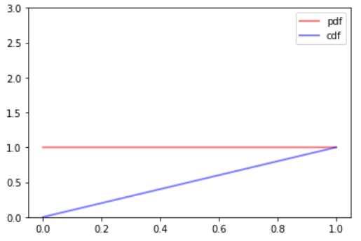
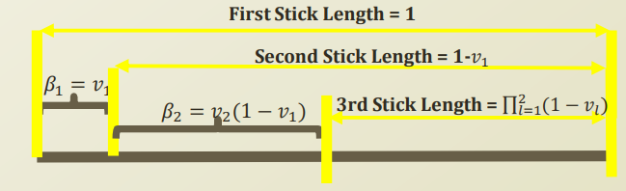
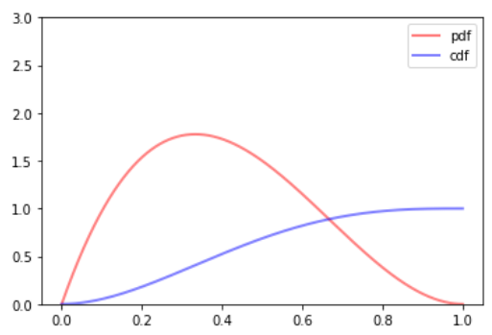
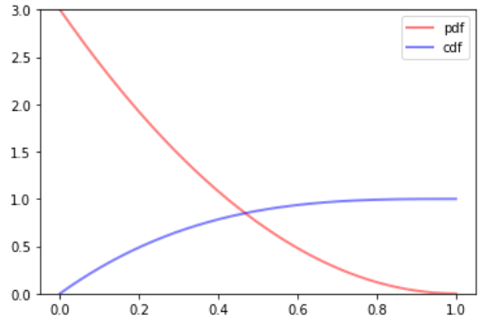

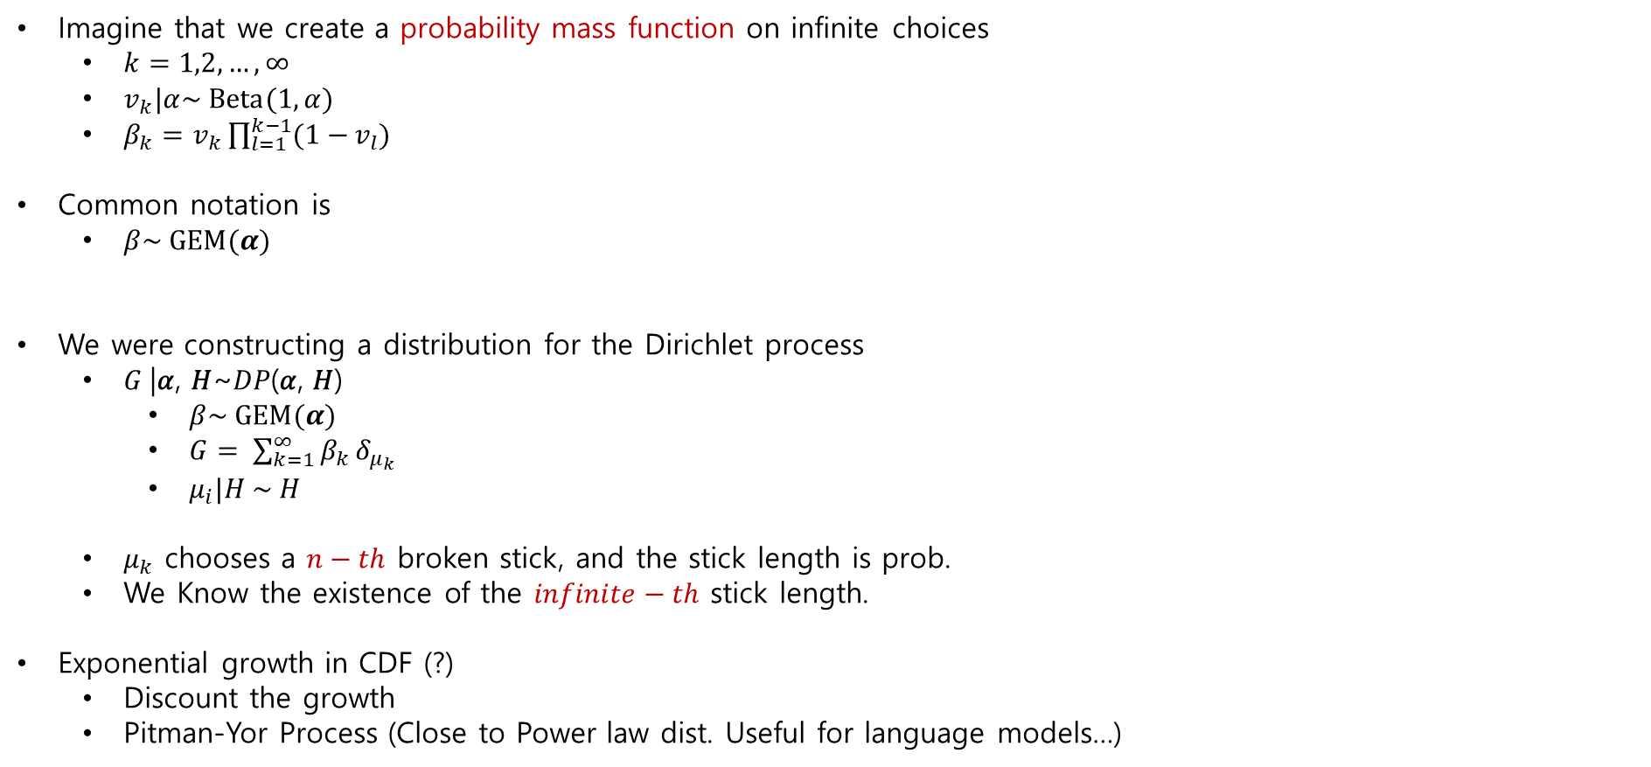




Dirichlet Process
Stick-Breaking Construction (https://assaeunji.github.io/bayesian/2019-01-06-dp/)
$$Beta(α,β)$$
Imagine that we create a probability mass function on infinite choices
$k=1,2, …, ∞$
$v_{k}|α\sim Beta(1,α)$
$β_{k}=v_{k}\prod_{l=1}^{k−1}{(1−}v_{l})$
Common notation is
$β\sim GEM(α)$
We were constructing a distribution for the Dirichlet process
$G$|𝛼, 𝐻~𝐷𝑃(𝛼, 𝐻)
$β\sim GEM(α)$
$G= \sum_{k=1}^{∞}{β_{k}}δ_{μ_{k}}$
$μ_{i}|H \sim H$
$μ_{k}$ chooses a $n−th$ broken stick, and the stick length is prob.
We Know the existence of the $infinite−th$ stick length.
Exponential growth in CDF (?)
Discount the growth
Pitman-Yor Process (Close to Power law dist. Useful for language models…)
discrete variable(PMF)
$$Beta(1,1)$$
$$Beta(1,α)$$
fix(1) , control($α$)
“$α$” control 하여 활용 → 즉, “$α$”에 따른 순차적으로 Cluster의 size가 달라짐!
$$Beta(2,3)$$
0
1
$$Beta(1,3)$$

Slide 10
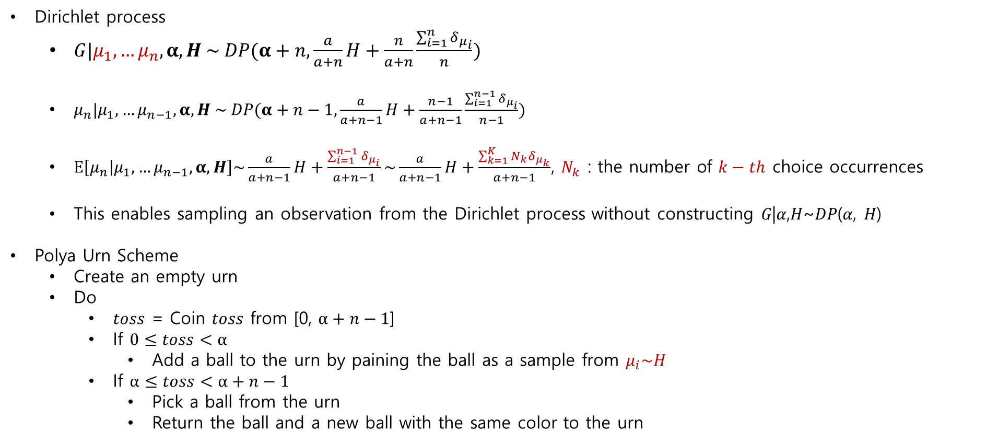
Dirichlet Process
Polya Urn Scheme (sampling Scheme)
Dirichlet process
$G|μ_{1}, …μ_{n},α, H \sim DP(α+n,\frac{a}{a+n}H+\frac{n}{a+n}\frac{\sum_{i=1}^{n}{δ_{μ_{i}}}}{n})$
$μ_{n}|μ_{1}, …μ_{n−1},α, H \sim DP(α+n−1,\frac{a}{a+n−1}H+\frac{n−1}{a+n−1}\frac{\sum_{i=1}^{n−1}{δ_{μ_{i}}}}{n−1})$
$E\left[μ_{n} | μ_{1}, …μ_{n−1},α, H\right]\sim \frac{a}{a+n−1}H+\frac{\sum_{i=1}^{n−1}{δ_{μ_{i}}}}{a+n−1}\sim \frac{a}{a+n−1}H+\frac{\sum_{k=1}^{K}{{N_{k}δ}_{μ_{k}}}}{a+n−1}$, $N_{k}$ : the number of $k−th$ choice occurrences
This enables sampling an observation from the Dirichlet process without constructing 𝐺|𝛼,𝐻~𝐷𝑃(𝛼, 𝐻)
Polya Urn Scheme
Create an empty urn
Do
$toss$ = Coin $toss$ from [$\text{0,} α+n−1$]
If $0≤toss<α$
Add a ball to the urn by paining the ball as a sample from $μ_{i}\sim H$
If $α≤toss<α+n−1$
Pick a ball from the urn
Return the ball and a new ball with the same color to the urn
posterior
Data point 마다의 선택
Cluster 마다의 선택
항아리

Slide 11
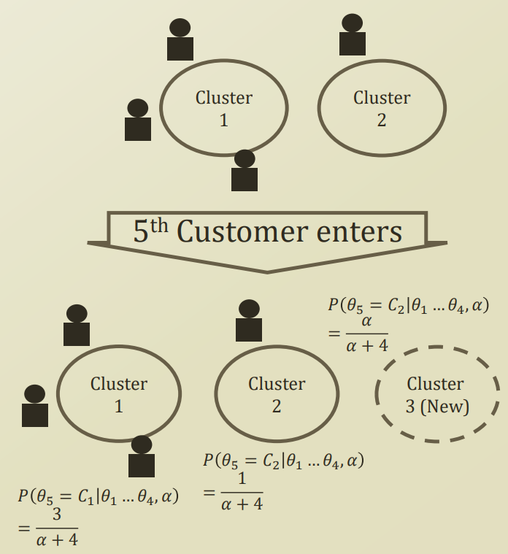


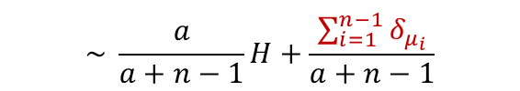

Dirichlet Process
Chines Restaurant Process
Dirichlet process
$G|μ_{1}, …μ_{n},α, H \sim DP(α+n,\frac{a}{a+n}H+\frac{n}{a+n}\frac{\sum_{i=1}^{n}{δ_{μ_{i}}}}{n})$
$E\left[μ_{n} | μ_{1}, …μ_{n−1},α, H\right]$
$p\left(μ_{n}\right|μ_{1}, …μ_{n−1},α)= \left\{\begin{aligned}\frac{N_{k}}{a+n−1} \\ \frac{a}{a+n−1}\end{aligned}\right.$
Chinese restaurant process
Assume Infinite number of tables in a restaurant
First customer sits at the first table
Loop for Customer N sits at:
1) Table $k$ with $p\left(μ_{n}\right|μ_{1}, …μ_{n−1},α)=\frac{N_{k}}{a+n−1}$
2) A new table $k+1$ with $p\left(μ_{n}\right|μ_{1}, …μ_{n−1},α)=\frac{a}{a+n−1}$
$$\sim \frac{a}{a+n−1}H+\frac{\sum_{i=1}^{n−1}{δ_{μ_{i}}}}{a+n−1}$$
$$\sim \frac{a}{a+n−1}H+\frac{\sum_{k=1}^{K}{{N_{k}δ}_{μ_{k}}}}{a+n−1}$$
$N_{k}$ : the number of $k−th$ choice occurrences
$k−th$ cluster에 할당된 data 갯수

Slide 12
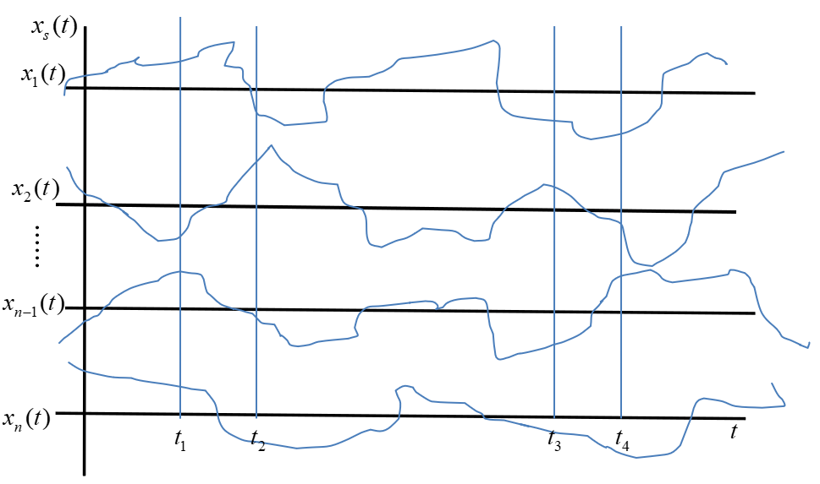
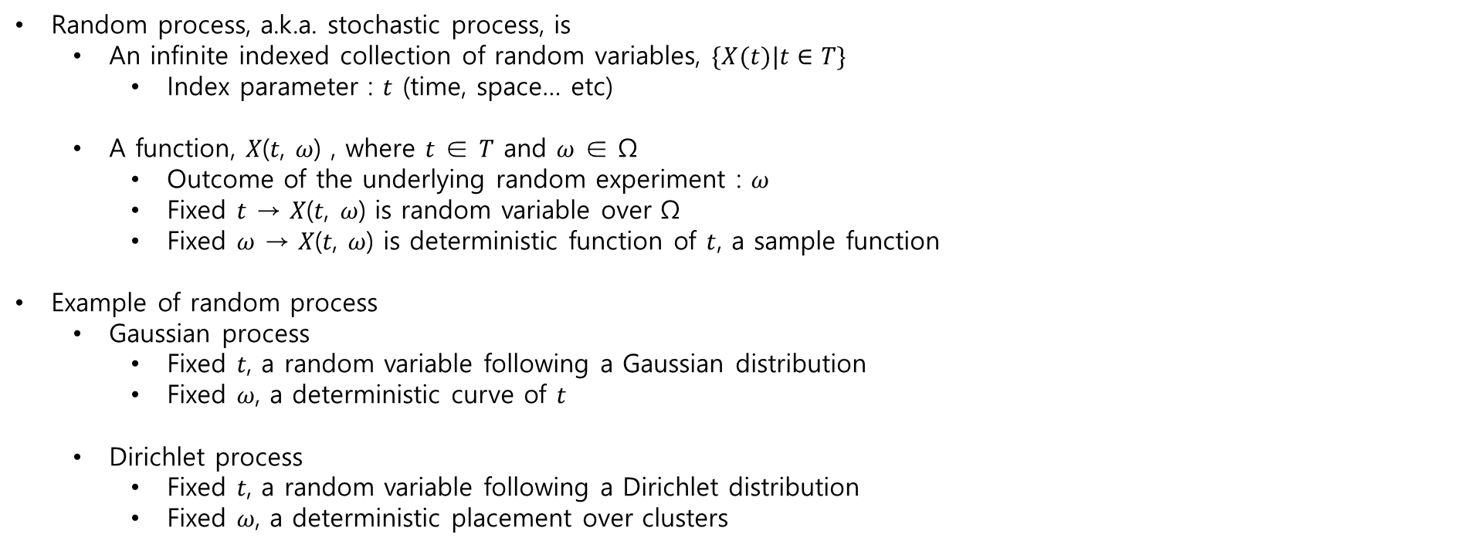
Dirichlet Process
Detour : Random Process
Random process, a.k.a. stochastic process, is
$\text{An} \text{infinite} \text{indexed} \text{collection} \text{of} \text{random} \text{variables}\text{,}$ $\{X(t)|t∈T\}$
Index parameter : $t$ (time, space… etc)
$\text{A} \text{function}\text{, }\text{X}\text{(}\text{t}\text{, }\text{ω}\text{)} \text{, }\text{where} \text{t}\text{ ∈ }\text{T} \text{and} \text{ω}\text{ ∈ }\text{Ω}$
Outcome of the underlying random experiment : $\text{ω}$
Fixed $t$ → $\text{X}\text{(}\text{t}\text{, }\text{ω}\text{)}$ is random variable over $\text{Ω}$
Fixed $\text{ω}$ → $\text{X}\text{(}\text{t}\text{, }\text{ω}\text{)}$ is deterministic function of $t$, a sample function
Example of random process
Gaussian process
Fixed 𝑡, a random variable following a Gaussian distribution
Fixed 𝜔, a deterministic curve of $\text{t}$
Dirichlet process
Fixed 𝑡, a random variable following a Dirichlet distribution
Fixed 𝜔, a deterministic placement over clusters

Slide 13
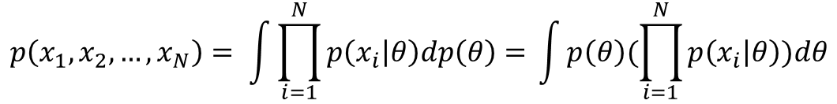
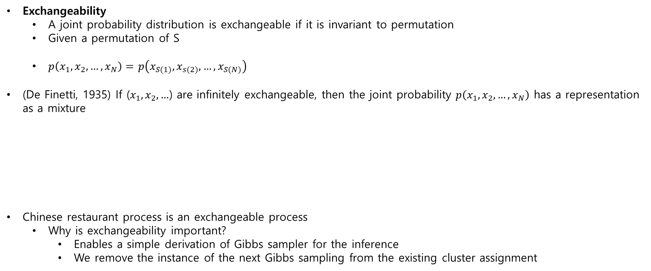
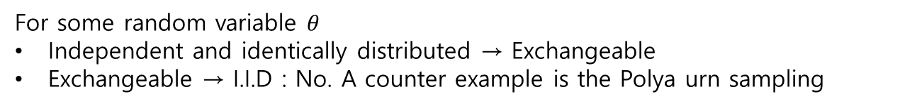
Dirichlet Process
de Finetti’s Theorem
Exchangeability
A joint probability distribution is exchangeable if it is invariant to permutation
Given a permutation of S
$p\left(x_{1},x_{2}, …,x_{N}\right)=$ $p\left(x_{S(1)},x_{s(2)}, …,x_{S(N)}\right)$
(De Finetti, 1935) If ($x_{1},x_{2}, …$) are infinitely exchangeable, then the joint probability $p\left(x_{1},x_{2}, …,x_{N}\right)$ has a representation as a mixture
Chinese restaurant process is an exchangeable process
Why is exchangeability important?
Enables a simple derivation of Gibbs sampler for the inference
We remove the instance of the next Gibbs sampling from the existing cluster assignment
$$p\left(x_{1},x_{2}, …,x_{N}\right)= \int{\prod_{i=1}^{N}{p\left(x_{i} | θ\right)dp\left(θ\right)= }}\int{p\left(θ\right)(\prod_{i=1}^{N}{p\left(x_{i} | θ\right)})dθ}$$
For some random variable $θ$
Independent and identically distributed → Exchangeable
Exchangeable → I.I.D : No. A counter example is the Polya urn sampling

Slide 14
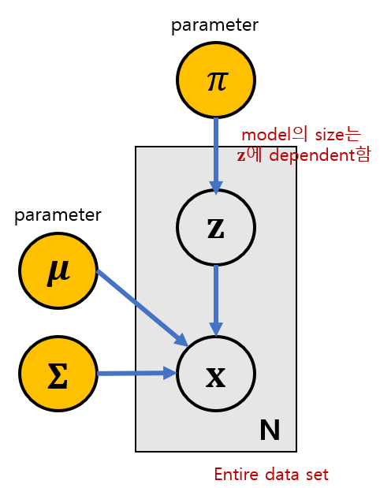









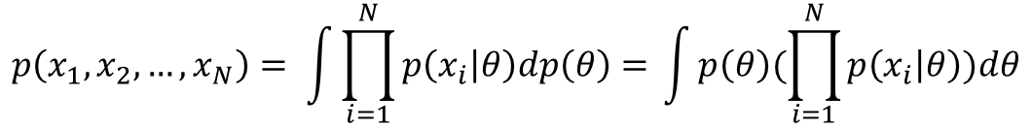




$$p\left(x_{1},x_{2}, …,x_{N}\right)= \int{\prod_{i=1}^{N}{p\left(x_{i} | θ\right)dp\left(θ\right)= }}\int{p\left(θ\right)(\prod_{i=1}^{N}{p\left(x_{i} | θ\right)})dθ}$$
Dirichlet Process
Dirichlet Process Mixture Model
Common usage of Dirichlet process : Prior on parameters of a mixture model
Like a GMM
$z_{k}∈\left\{0,1\right\}$
$\sum_{k=1}^{K}{z_{k}}=1$
$P\left(z_{k}=1\right)=π_{k}$
$\sum_{k=1}^{K}{π_{k}}=1$
$0≤π_{k}≤1$
Indicator representation of GMM with infinite K
$β|γ\sim GEM\left(γ\right)$ → stick-breaking (distribution을 scheme하는 constuction 기법)
$β|γ\sim GEM\left(a\right)→k=1,2, …,∞$
$v_{k}|a\sim Beta(1,a)$
$β_{k}=v_{k}\prod_{l=1}^{k−1}{(1−}v_{l})$
$θ_{k}|H→$ base distribution
$θ\sim H\left(λ\right)→′{\text{θ}}^{′}는 ′H\left(λ\right)′에$서 sampling
$z_{i}|β\sim β→′z^{′}는 ′β(multinomial)′$가 주어졌을 때, 선택지를 뽑는 경우
$x_{i}|{\left\{θ_{k}\right\}}_{k=1}^{∞}→$ 특정 cluster를 선택했을 때, $x_{i}가$ 나올 확률
$x_{i}\sim F(θ_{z_{i}})$
Indicator View
Graphical Model
Alternative
Representation
For Mixture
Models
$$H\left(λ\right)$$
$$γ$$
$$β$$
$$γ$$
$$G_{0}$$
Using bayesian
treatment
0
1
$$λ$$
$$z$$
$$θ^{′}$$
$$θ$$
$$x$$
$$x$$
$$∞$$
N
N

Slide 15

$$p\left(x_{1},x_{2}, …,x_{N}\right)= \int{\prod_{i=1}^{N}{p\left(x_{i} | θ\right)dp\left(θ\right)= }}\int{p\left(θ\right)(\prod_{i=1}^{N}{p\left(x_{i} | θ\right)})dθ}$$
Dirichlet Process
Dirichlet Process Mixture Model
Alternative representation of GMM with infinite K
$G_{0}|H$
$γ\sim DP\left(γ | H\right)$
$θ_{i}^{′}|G_{0}\sim G_{0}$
$x_{i}|θ_{i}^{′}\sim F(θ_{i}^{′})$
Continuously updating the assignment of an instance
Learning concept
de Finetti’s theorem + Chinese restaurant process + Gibbs Sampling
Each assignment
Surely updates the parameter of each cluster
May create a new cluster
Indicator View
Graphical Model
Alternative
Representation
For Mixture
Models
$$H\left(λ\right)$$
$$γ$$
$$β$$
$$γ$$
$$G_{0}$$
Using bayesian
treatment
$$λ$$
$$z$$
$$θ^{′}$$
$$θ$$
$$x$$
$$x$$
$$∞$$
N
N

